Slide 1

Introduction
In our marketing campaigns analysis project, we have systematically examined a diverse range of data visualizations to extract meaningful insights regarding the performance of various marketing initiatives. These insights span across consumer demographics, transaction recency, and spending behaviors, giving us a holistic view of the impact of our marketing efforts.

Slide 2

Objective
The project’s goal is to evaluate the success of different marketing campaigns, understand the purchasing patterns of different customer segments, and optimize our marketing spend to enhance ROI. By doing so, we aim to refine our marketing strategies to better align with consumer preferences and to drive increased sales efficiency.

Slide 3

Visualization

Slide 4

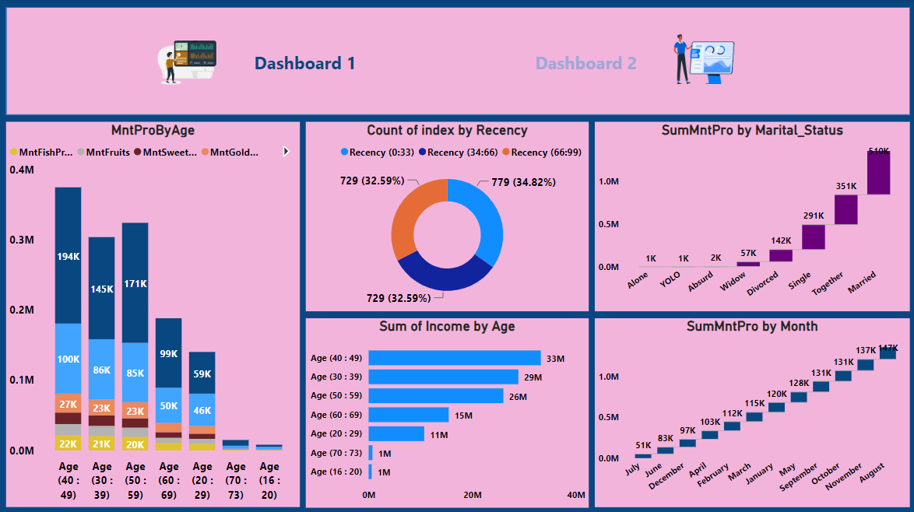
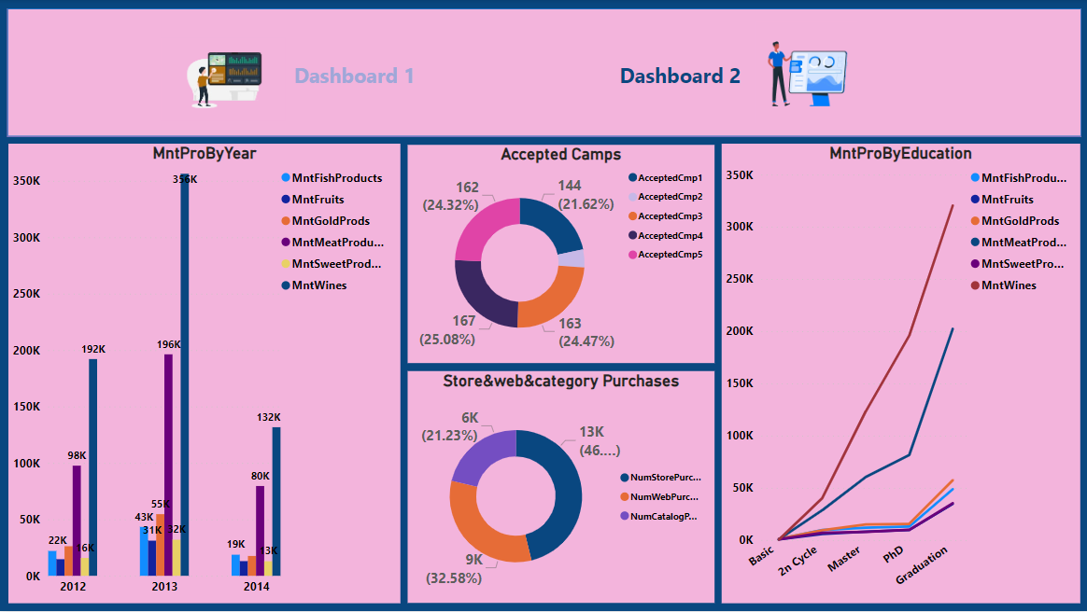
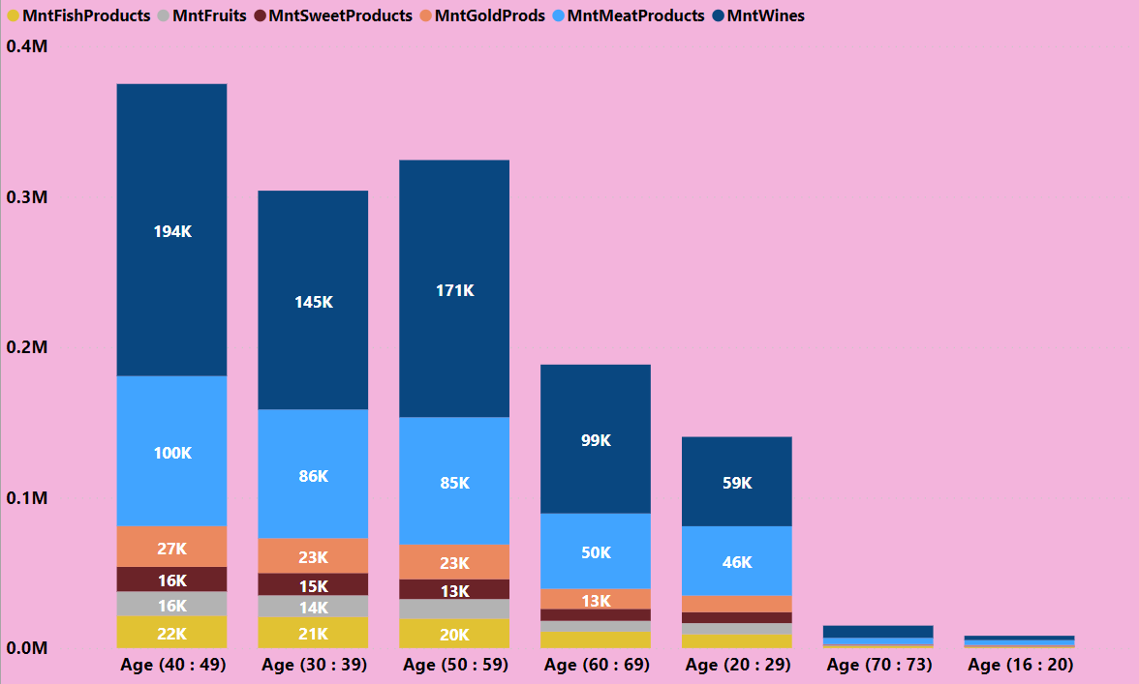
The core demographic for product sales appears to be individuals aged 40-49, who also have the highest income.
Customer interactions are fairly regular across recency periods, but slightly more customers interact in the middle recency bracket (34-66 days).
Marital status has a significant correlation with product spending, with married customers being the highest spenders.
The products seem to be more popular among older demographics with higher incomes, which might suggest targeting marketing efforts towards this group could be beneficial.
Overall, the data indicates a strong market presence among middle-aged individuals, particularly those who are married. Marketing and sales strategies could be tailored to further engage this demographic segment.

Slide 5

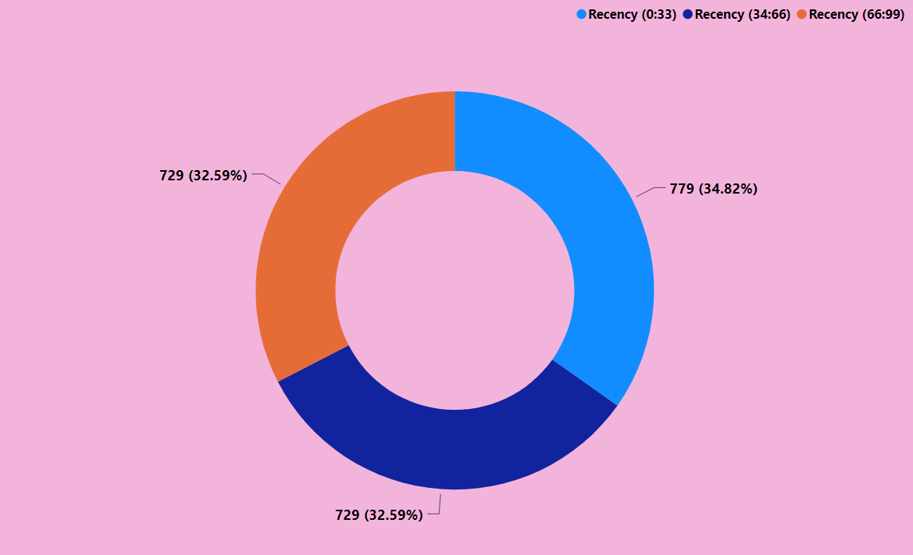
MntProByYear: Product sales peaked in 2012 and decreased by 2014. Wines are the top-selling category every year.
Accepted Camps: Campaigns 1 and 3 have higher acceptance rates, around 25% each, suggesting these are more effective.
Store & Web & Category Purchases: The majority of purchases are made in-store, with nearly half of all transactions.
MntProByEducation: As educational level rises, so does spending on products, with the highest spend among PhD holders.
Insights: Focus on the effective campaigns and in-store promotions, especially for wine. Tailor marketing strategies to higher education levels for increased spending

Slide 6

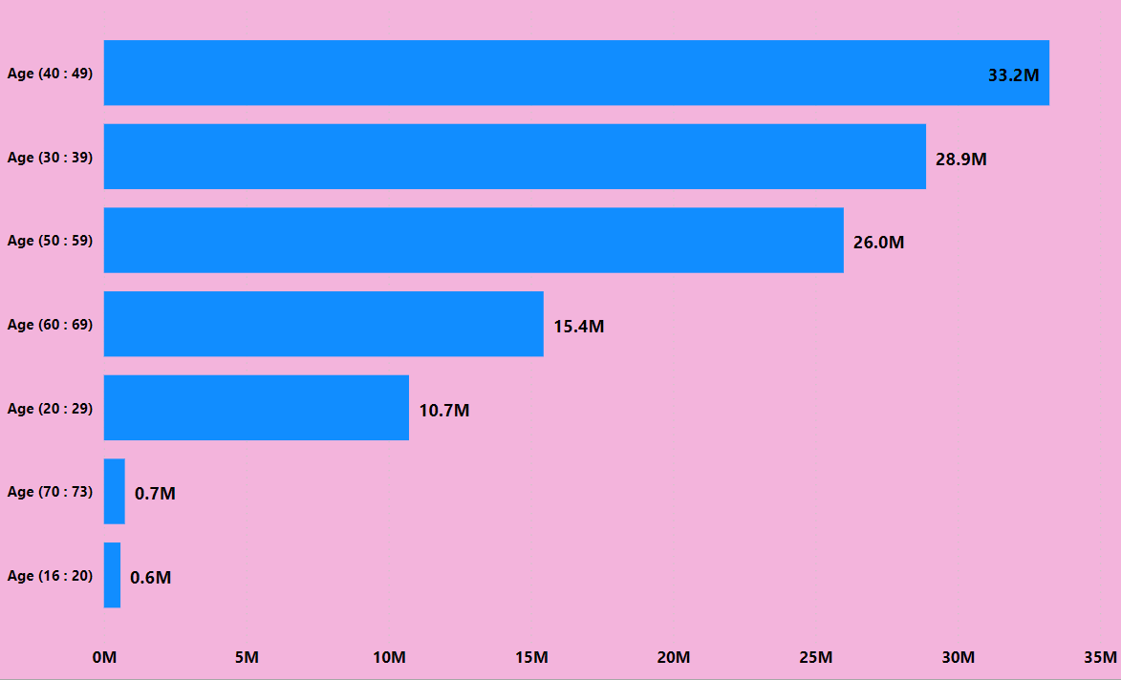
Age group 40-49 spends the most, especially on fish and gold products.
Spending drops significantly after age 60.
Youngest age groups (16-20, 20-29) have minimal spending across all categories.
Insight: Marketing should focus on the 40-49 age group and highlight fish and gold products, which are their preferred choices.

Slide 7

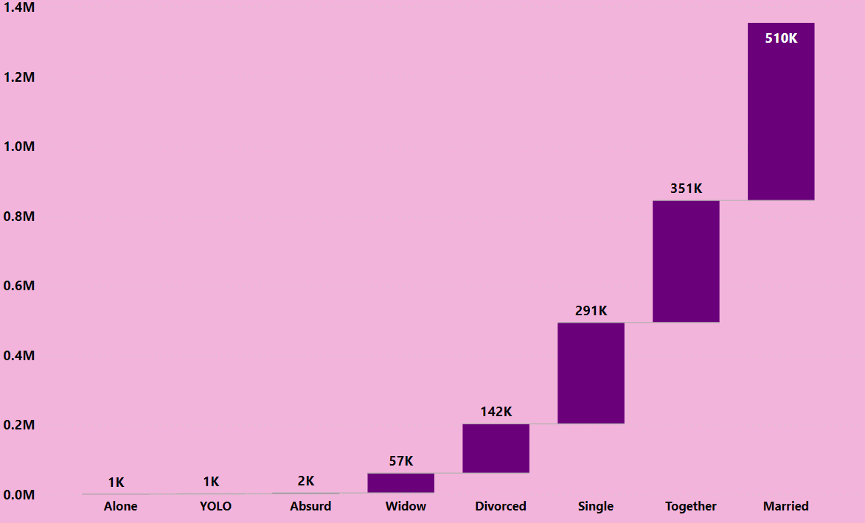
The donut chart shows customer engagement segmented by recency of interaction:
Similar interaction levels across all segments, indicating steady customer engagement over time.
Slightly higher interaction in the middle segment (34-66 days).
Insight: Maintain regular engagement strategies as customer interaction does not significantly drop over time.

Slide 8

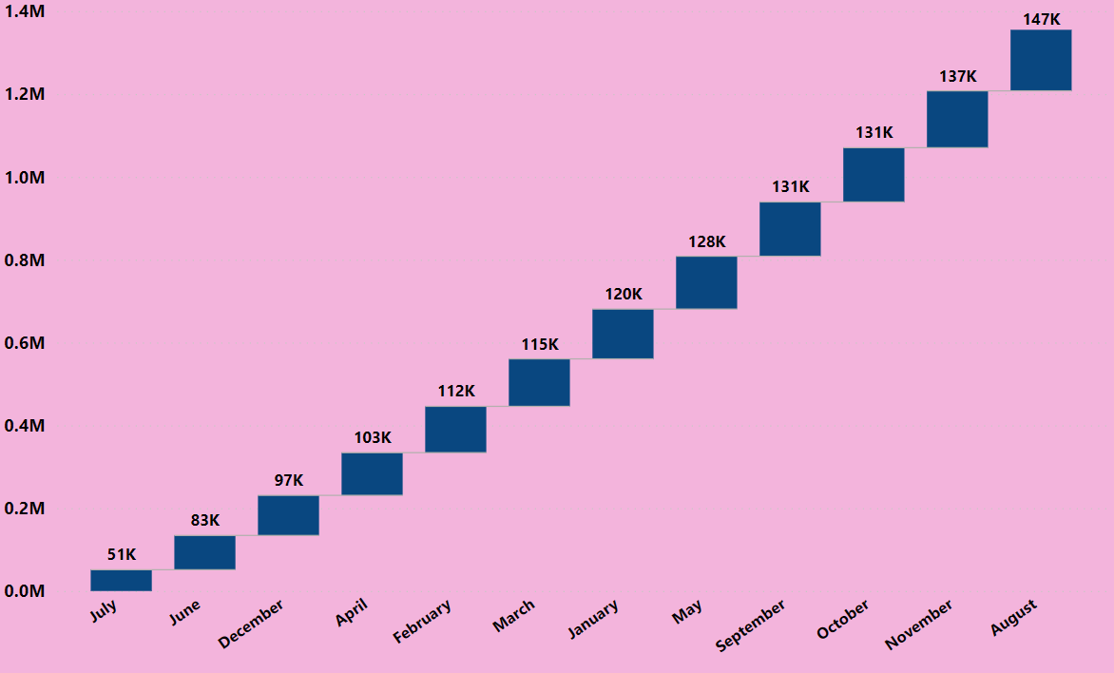
The horizontal bar chart indicates total income by age group:
The 40-49 age group has the highest income at 33.2M.
Income decreases significantly after age 60.
The youngest age group (16-20) has the lowest income.
Insight: Target the 40-49 age group for high-value products and services, as they have the most spending power.

Slide 9

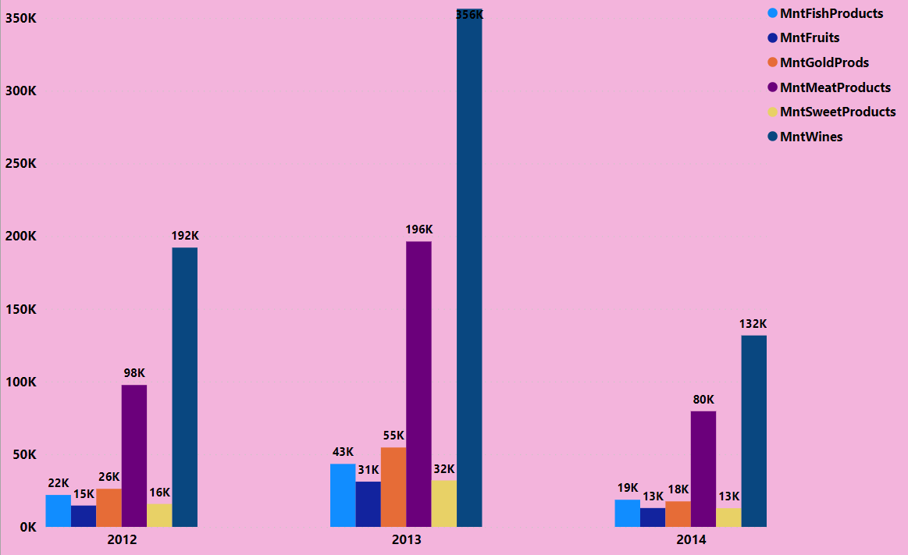
The bar chart shows product spending by marital status:
Married customers spend the most at 510K, followed by those living together.
Single, divorced, and widowed customers spend significantly less.
Spending for categories like "Alone", "YOLO", and "Absurd" is minimal.
Insight: Focus marketing and product offers on married and cohabiting customers, as they are the highest spenders.

Slide 10

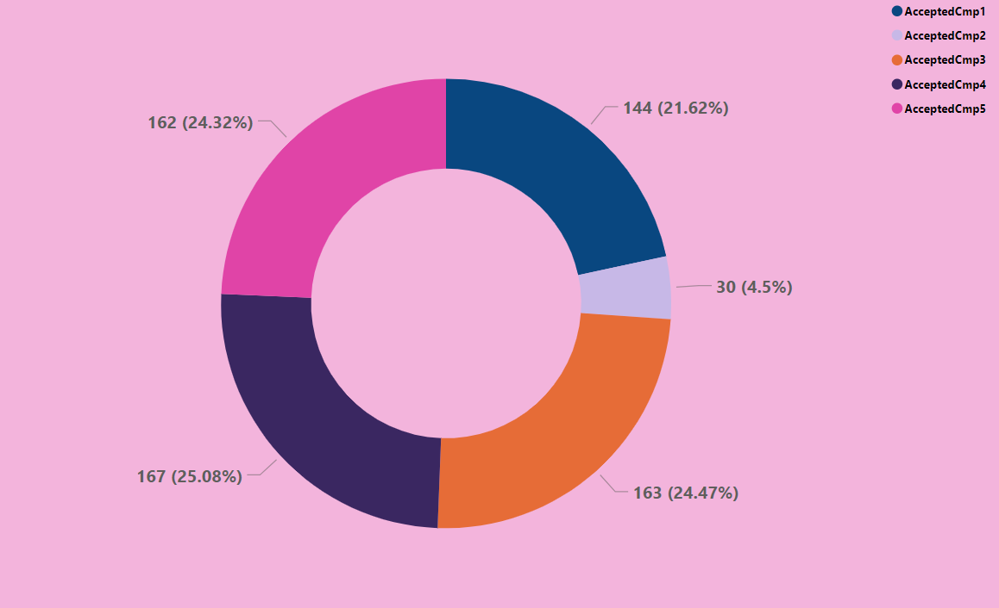
The bar chart shows product spending by month:
Highest spending in August (147K), lowest in February (51K).
A general increase in spending from the start to the end of the year.
Insight: Focus on maximizing sales and marketing efforts around the mid to late year, especially in August.

Slide 11

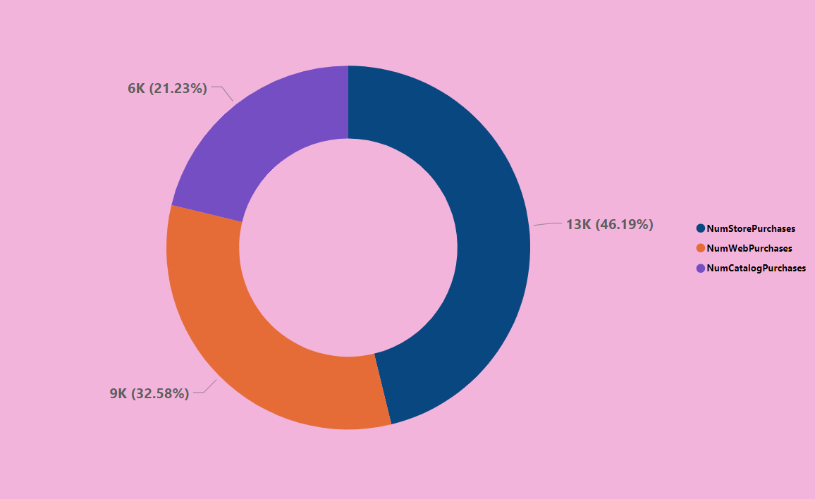
The bar chart displays product sales by year:
Sales peaked in 2013, particularly for meat products.
There's a significant drop in all product sales by 2014.
Fish products consistently generate revenue across years.
Insight: Investigate the 2013 spike, especially in meat sales, and address the overall sales decline in 2014. Maintain focus on fish products which show steady performance.

Slide 12

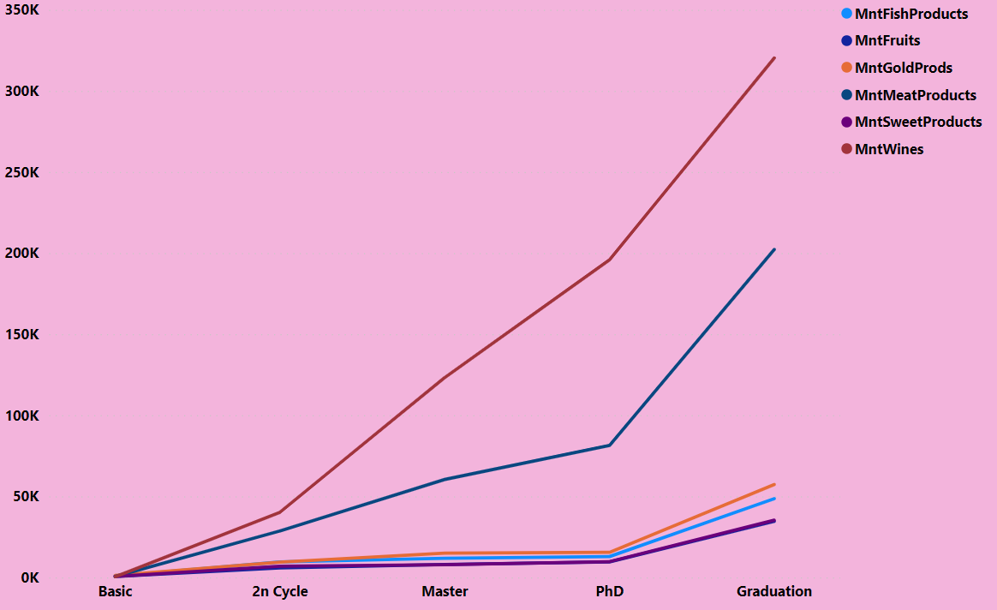
The donut chart represents acceptance rates for various campaigns:
Campaigns 1, 3, and 5 have higher acceptance rates, above 24% each.
Campaign 4 has the lowest acceptance at 4.5%.
Insight: Allocate more resources to campaigns 1, 3, and 5 due to their higher success rates, and reconsider or modify campaign 4's strategy.

Slide 13

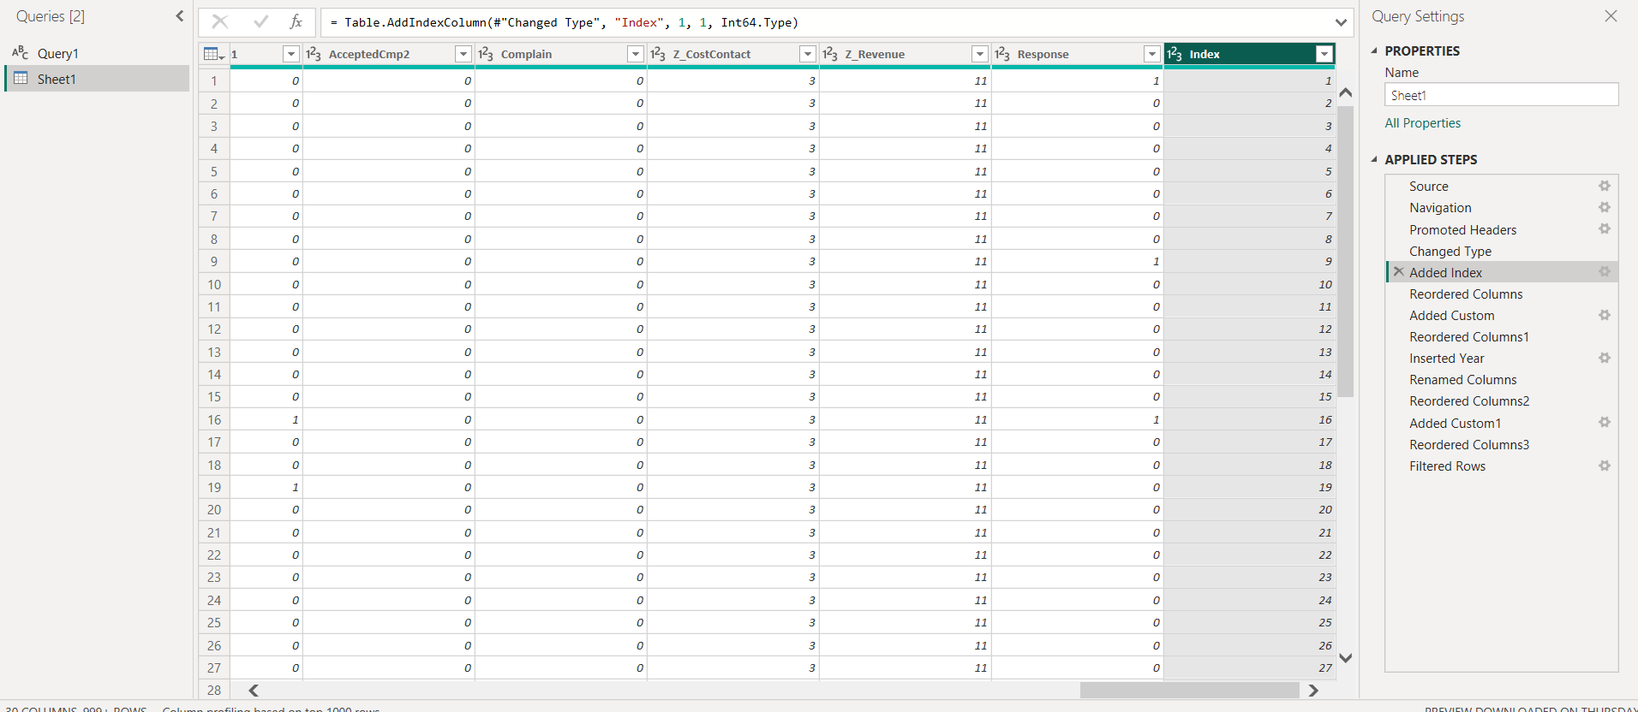
The donut chart shows the distribution of purchases across different sales channels:
Most purchases are made in-store (46.19%), followed by catalog (32.58%), and web (21.23%).
Insight: Strengthen in-store and catalog sales strategies as they are the most preferred channels by customers. Consider ways to enhance the online shopping experience to increase web purchases.

Slide 14

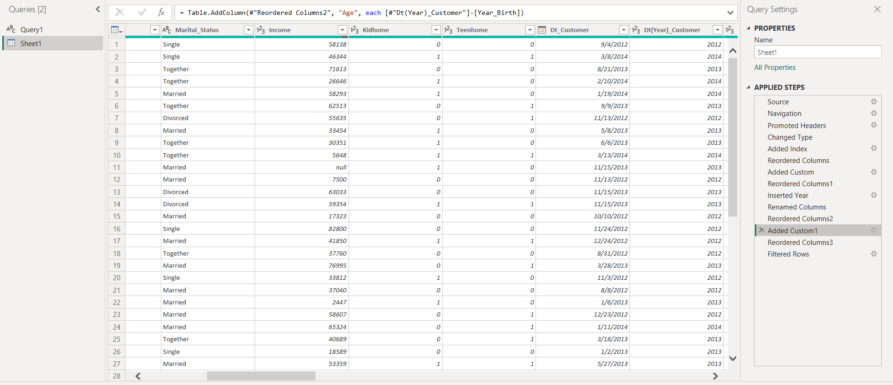
The line graph illustrates product spending across different educational levels:
Spending on all products increases with higher educational levels.
PhD holders have the highest spending, particularly on fish products which show a sharp increase.
Spending from those with basic education to those with a master's degree remains relatively flat for most products except fish.
Insight: Focus premium product targeting and marketing on individuals with higher education levels, as they exhibit greater spending power, especially on fish products.

Slide 15

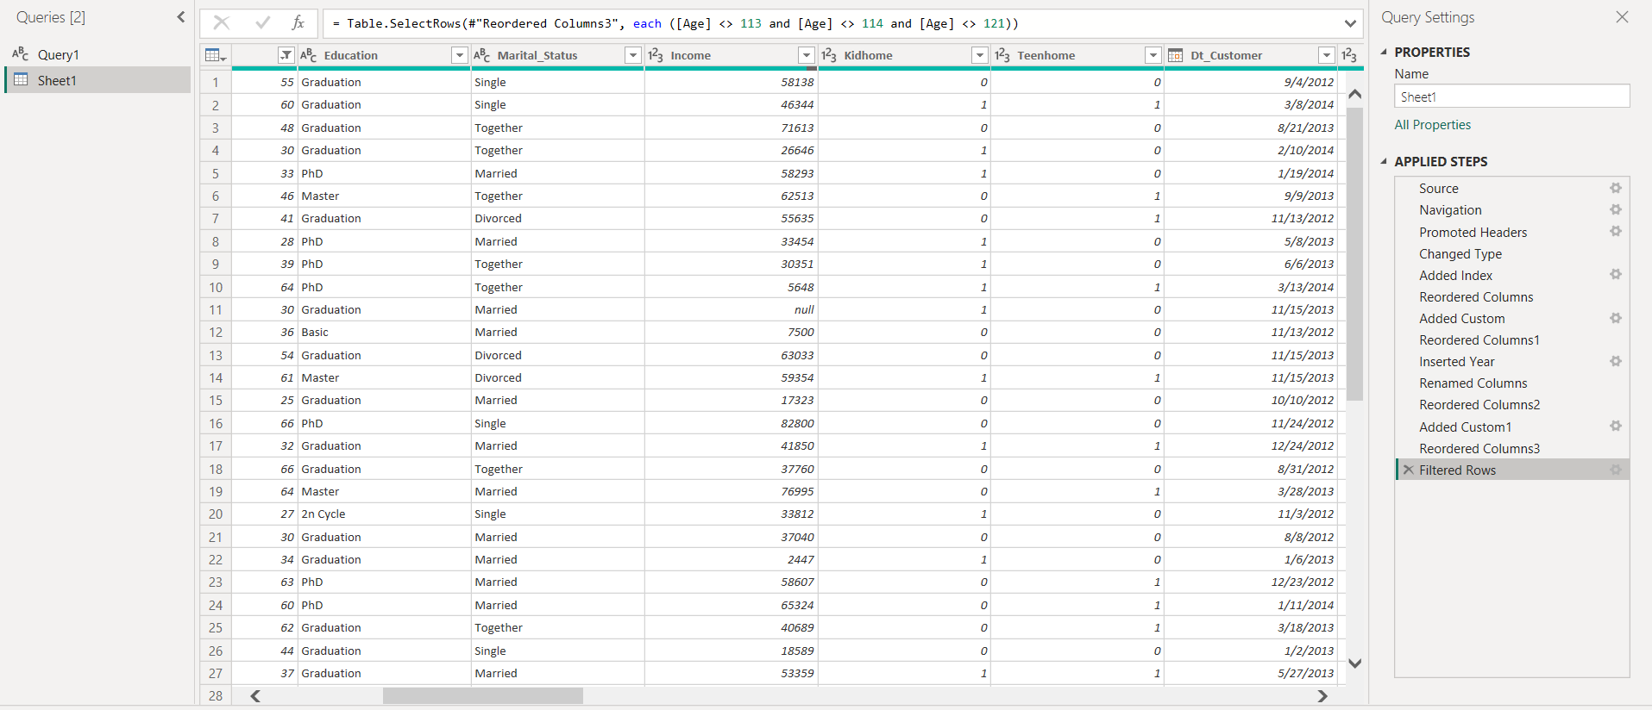
This process involves creating an index column and then repositioning it as the first column using Power Query.

Slide 16

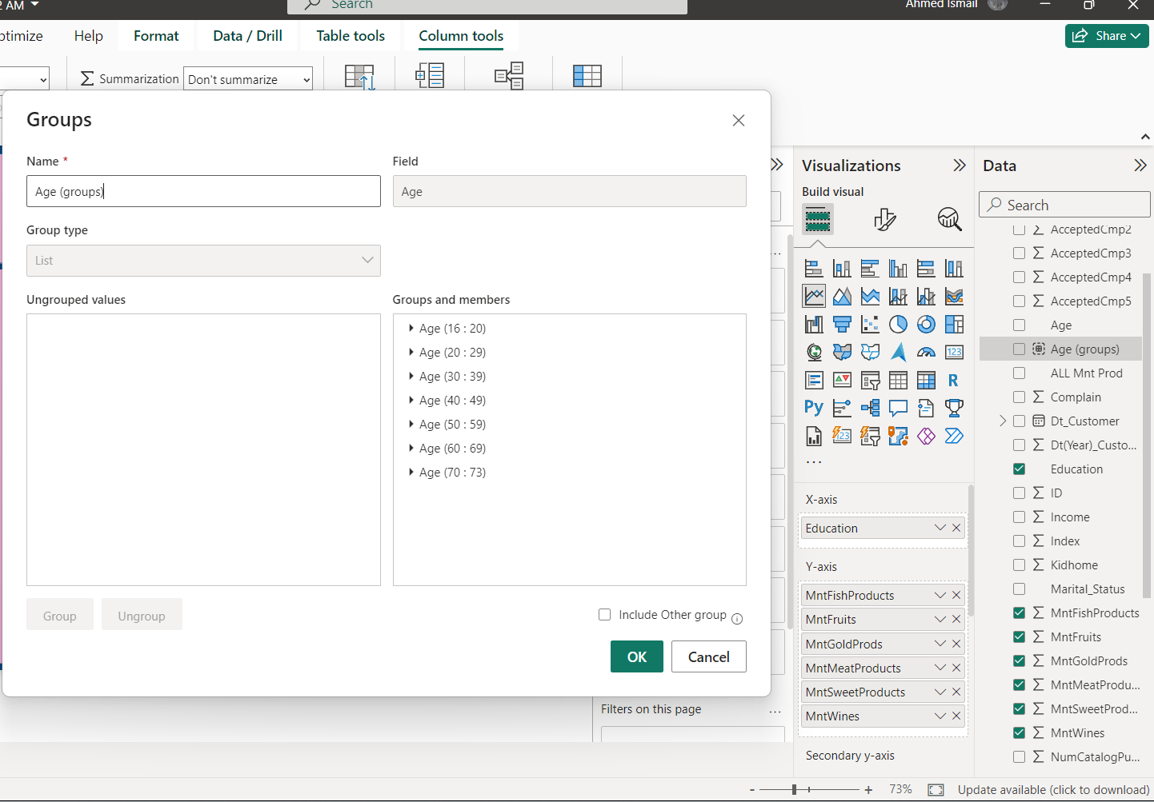
This involves creating a new column named 'Age', which calculates the difference in years between the 'Birth Date' of a customer and a reference 'Current Date'.

Slide 17
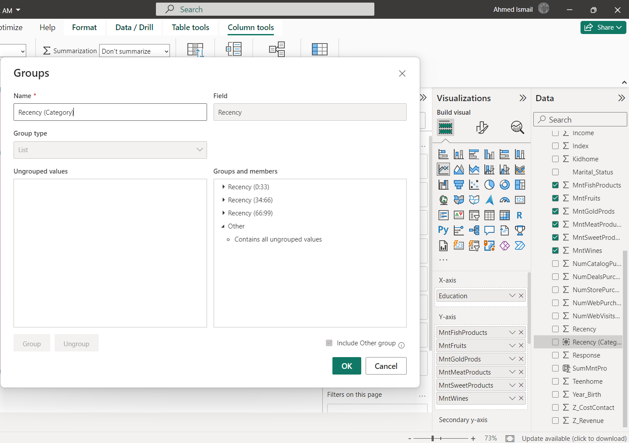
This refers to filtering out unrealistic values in the 'Age' column, specifically removing any entries where the age is greater than 110 years.

Slide 18

This involves creating age groups by categorizing individual ages into broader segments.

Slide 19

This involves creating recency groups by categorizing individual recency values into broader segments.

Slide 20

Conclusion
Effective campaigns (1, 3, and 5) and the 40-49 age demographic, particularly married individuals, emerged as prime targets for enhanced marketing focus. In-store sales lead, yet growth opportunities exist in online and catalog channels. Seasonal peaks in August also offer strategic timing for campaigns. Moving forward, investment should prioritize these insights to boost market share and revenue.

